Slide 1
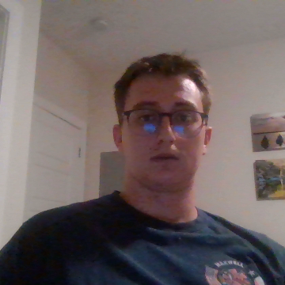
Climate Change in Austin?

Slide 2
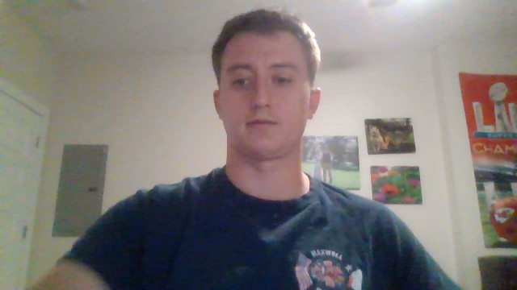
Question and Methods
Question: Does climate change warrant alterations to current husbandry standards?
Method: Let’s look at historical data for temperature, precipitation, and snowfall

Slide 3
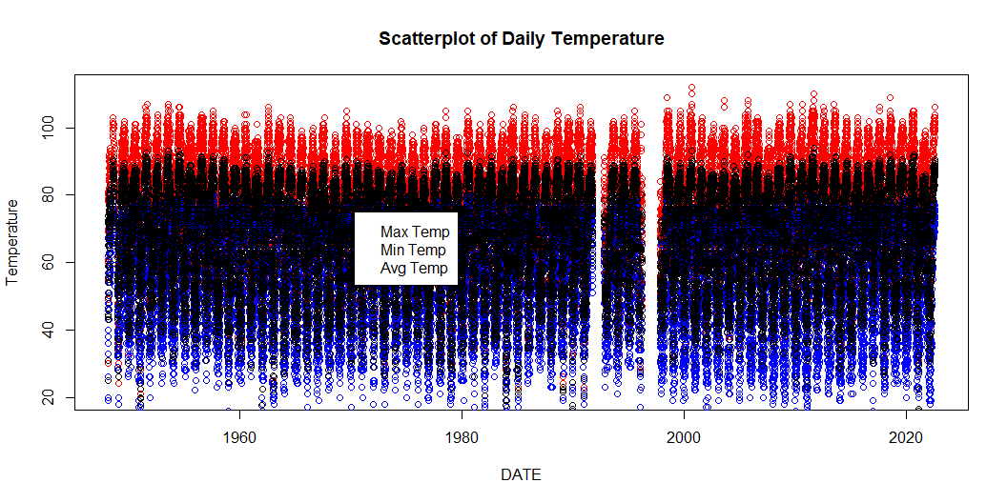
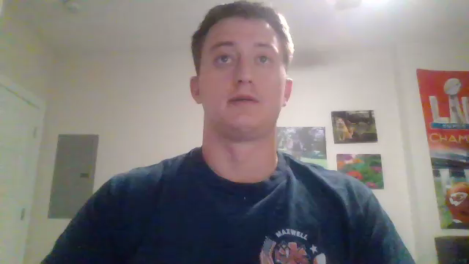
Daily Temperature - Scatterplot

Slide 4
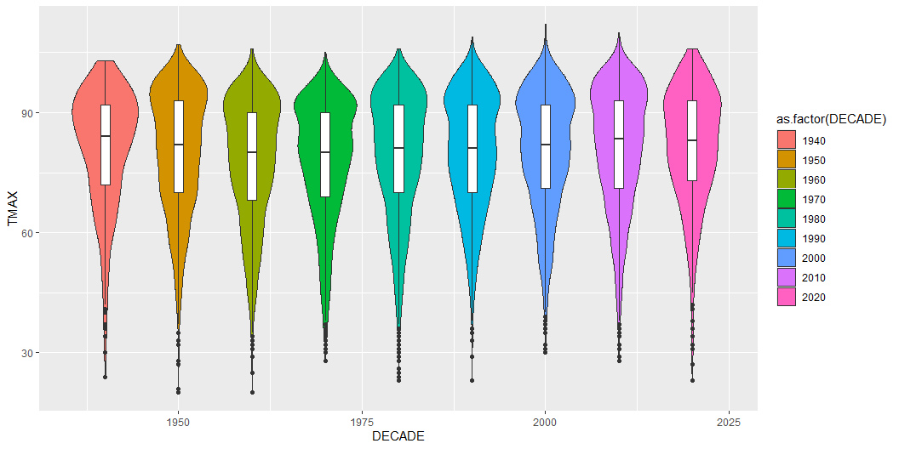
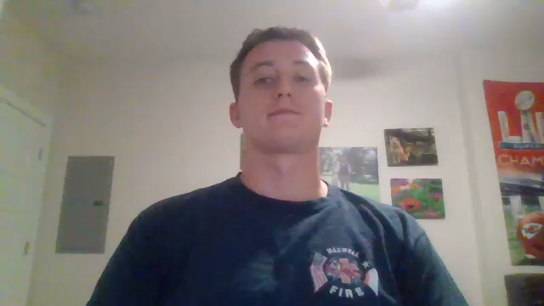
Temperature by Decade - Violin Plot

Slide 5
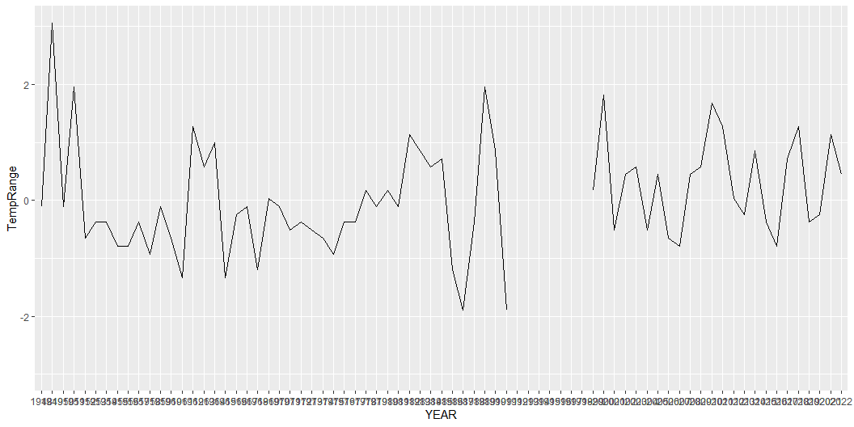
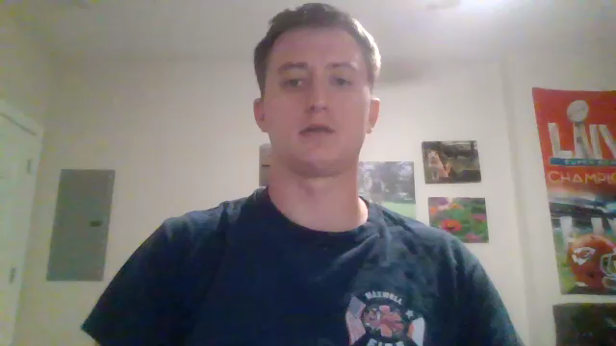
Normalized Temperature

Slide 6
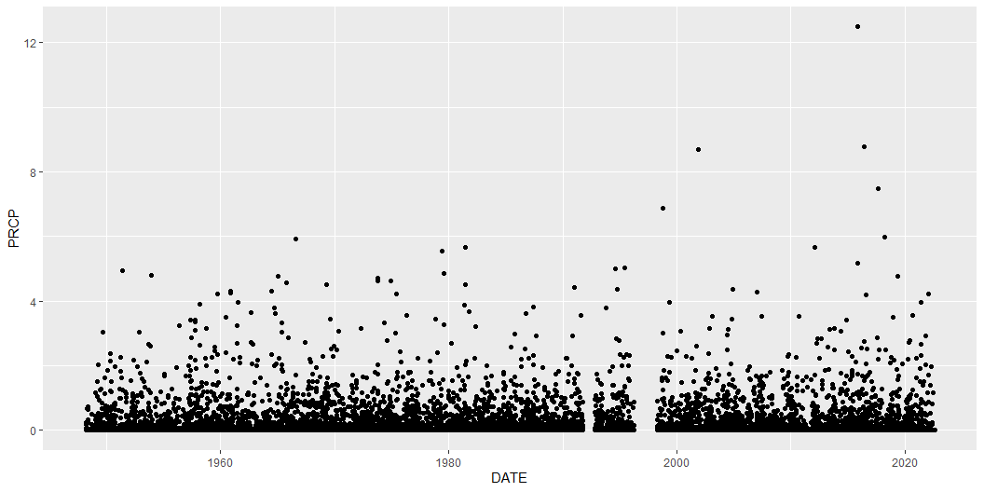
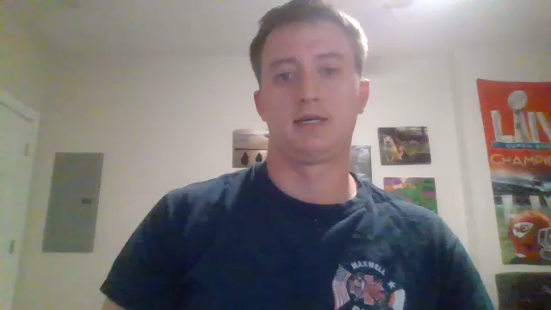
Daily Precipitation - Scatterplot

Slide 7
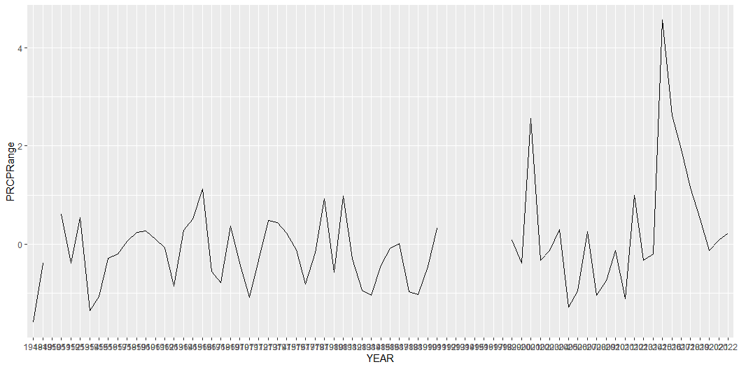
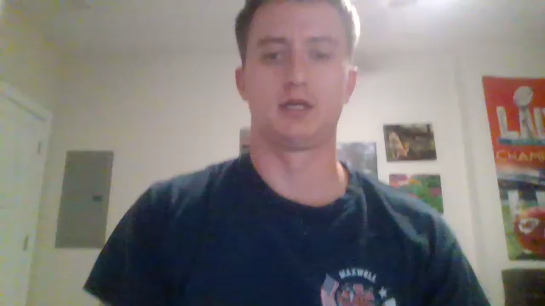
Normalized Precipitation

Slide 8
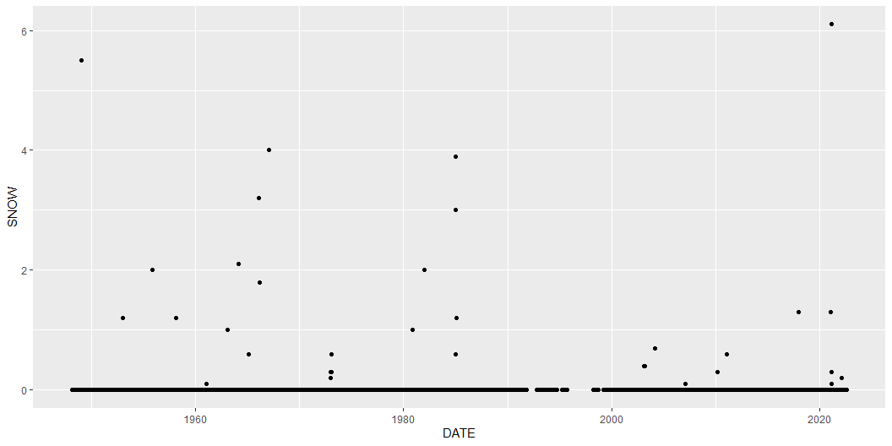
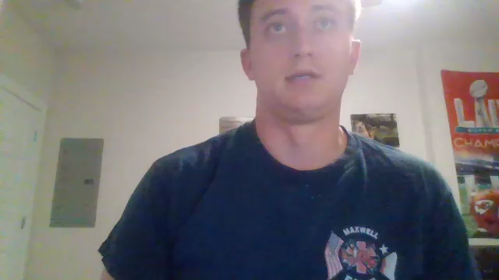
Daily Snowfall - Scatterplot

Slide 9
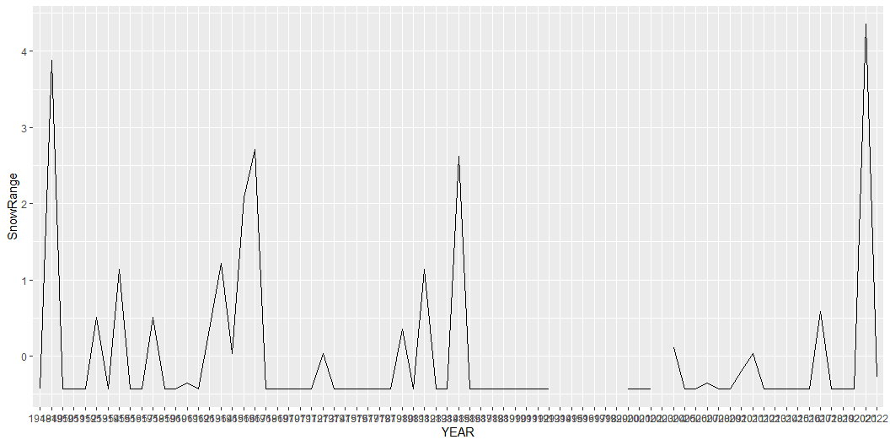
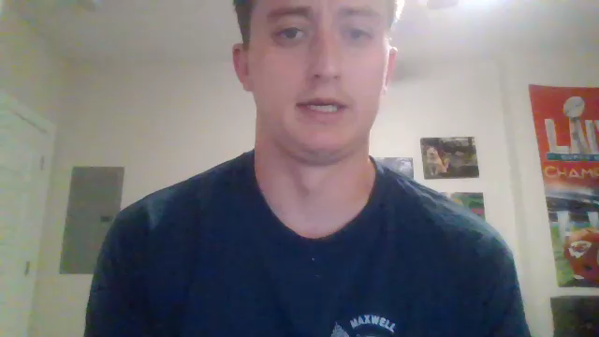
Normalized Snowfall

Slide 10
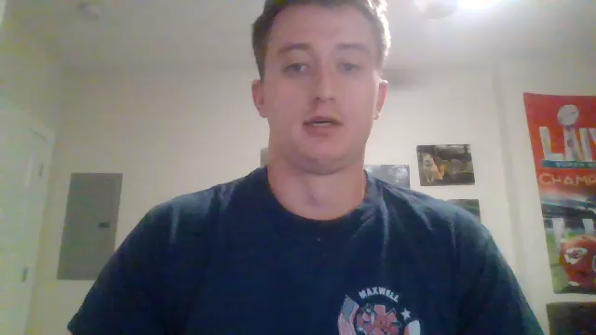
Conclusions and Further Research
While temperature extremes are less common, temperature is steadily increasing. More concerning than temperature swings are the extreme range of precipitation and snowfall in recent years.
Further work can include researching dynamical systems stability via the use of the Lyapunov Function or the incorporation of one of the National Weather Service models outlined by Harry Glahn’s paper “Statistical Weather Forecasting”

